Slide 1


E911

Slide 2
What is 911 – Emergency Number?
911 is the official national emergency number in the United States and Canada.
Dialing 911 quickly connects you to a Public Safety Answering Point (PSAP) dispatcher trained to route your call to local emergency medical, fire, and law enforcement agencies.
Under a federal law enacted in 1999, 911 replaced all other emergency telephone numbers.
Most 911 systems now automatically report the telephone number and location of 911 calls made from wire line phones, a capability called Enhanced 911 or E911.

Slide 3
NeuStar’s E911 Service
Provides a gateway/interface to LEC Automatic Location Identification (ALI) databases via one of the following third-party vendors
  The Schofield Group
  Intrado
Provides a flow-through of specific data elements that identify the geographic locations of the 911 caller.
Offered as a stand-alone product through Basic Service or as bundled with other Local products (LSR, SOA, LIDB, CARE) through Managed Service

Slide 4
How does NeuStar’s E911 process work?
Generates an E911 NENA standard record & formats E911 record based on LEC specific requirements.
Verifies address accuracy with each LEC’s Master Street Address Guide (MSAG).
Verifies NPA/NXX ownership to determine accurate action codes, i.e., migrate in lieu of install or delete vs unlock. (TSG ONLY)
Ensures unlock submission is made by former LSP. (TSG ONLY)
Uploads validated records to LEC’s ALI database.
Verifies records accepted and makes corrections if necessary. (TSG ONLY)
Processes all LNP ANIs at port date.
Resolves E911 NRF (No Record Found) alerts. (TSG ONLY)

Slide 5
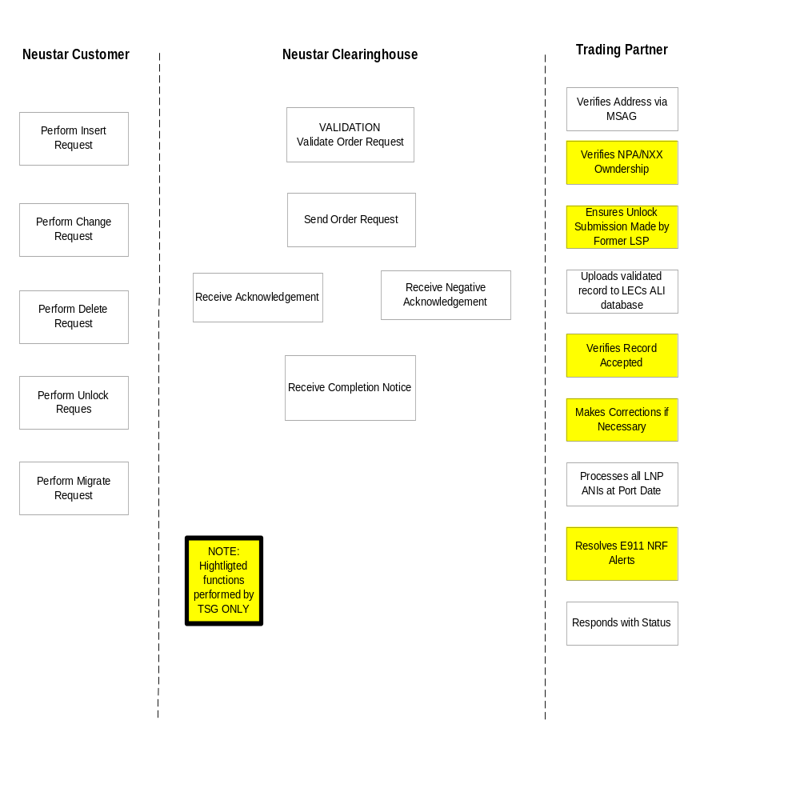
E911 – Process Diagram

Slide 6
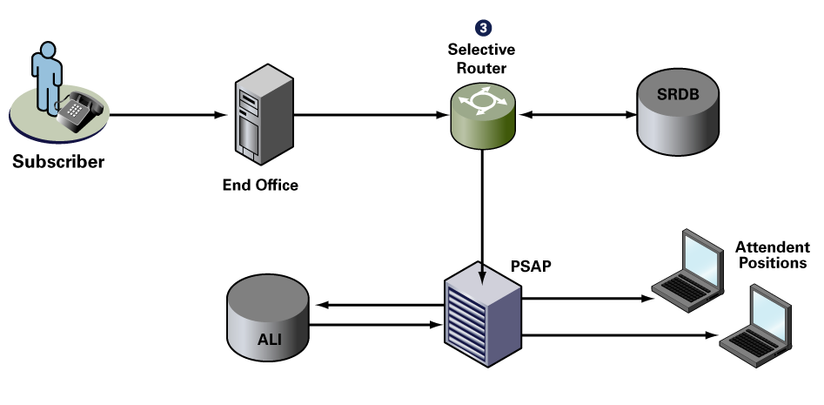
How E9-1-1 works (wire line)

Slide 7
Activity Type
Type of activity
  C = Change
  D = Delete
  I = Insert
  U = Unlock (LNP)
  M = Migrate (LNP)

Slide 8
Confirmation Response
The response has been processed by the SCC.
The response has been forwarded to a non-hosted ILEC for processing.
The request is assumed to have been processed by a non-hosted ILEC, since no error response has been received from the ILEC.

Slide 9
Client
Losing Provider
Illuminet
Intrado
Start
1
LSR (NP/LSNP) request
2
Firm order confirmation (FOC)
3
SSD and Pull LNP requests
LNP Pull acknowledgement
4a
Inform ILEC of porting
4b
5
ILEC accepts porting
6
LNP telephone list request
LNP telephone list response
7
8
LNP activation request sent on
due date
LNP activation notification
9a
LNP activation notification
9b
Service order confirmation (SOC)
10
11
Unlock E-911 record
12
Update E-911 record
13
LSR (Directory Service) request
FOC
14
SOC
15
End
Provision other value-
added services, such as
LIDB, CNAM, etc.

Slide 10
E-911 Message Flow
Intrado hosts ALI databases
  Ameritech
  BellSouth
  Qwest
Intrado forwards E-911 Requests for other ILECs

Slide 11
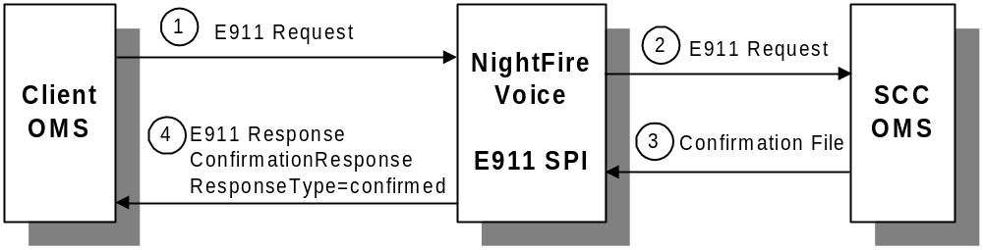
Successful Request and Response for Hosted ILEC

Slide 12
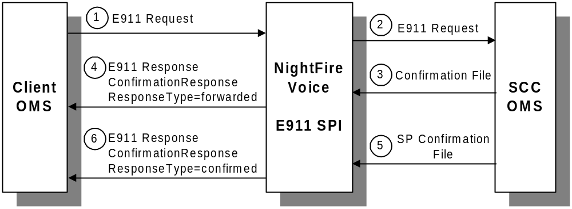
Successful Requests and Responses for Nonhosted ILECs

Slide 13
E-911 Response Information
Confirmations - This file contains all records processed from a single SOI file. The original record is returned with an accompanying confirmation code. The confirmation code designates the status of each record (i.e., in error, FWD-forwarded, or 000 - no error).
Daily Error Correction Confirmation (DECC) - This file contains any errors that have been corrected by Intrado over the previous 24 hours.
Outstanding Errors - This file contains any errors that are currently in the Intrado error database to date.
Referred Responses - This file lists MSAG-related and LNP errors and explains whether Intrado was successful in correcting the error or whether the record requires research from the TelConnect customer.
SP Confirmations - This file contains one-for-one status for all SOI records sent to non-Intrado ALI providers (ILECs). It indicates if the ILEC returned a positive confirmation that the record processed correctly, if it can be assumed the record processed correctly, or any error code associated with the record.
Statistics - This file confirms the total number of records received in the SOI file, how many records processed without error, and how many records were in error

Slide 14

DATABASE

Slide 15
Database Information
The E-911 database schema consists of three tables:
E911_MESSAGE
NENA_MESSAGE
SOI_FILE

Slide 16
Database Tables
DESC E911_MESSAGE;
E911MESSAGEKEY NUMBER(10)
CUSTOMERID NOT NULL VARCHAR2(10)
TELEPHONENUMBER VARCHAR2(32)
CREATED NOT NULL TIMESTAMP(0)
ORDERNUMBER VARCHAR2(16)
E911BATCHNUMBER NUMBER(10)
MESSAGETYPE NOT NULL VARCHAR2(32)
RESPONSETYPE VARCHAR2(32)
MESSAGE LONG
INTERFACEVERSION VARCHAR2(10)
USERID VARCHAR2(32)
ACTION VARCHAR2(50)
APPLYBUSINESSRULES NOT NULL NUMBER(1)
ILEC NOT NULL VARCHAR2(30)
ORDEROID NUMBER(38)
TRANSOID NUMBER(38)
INPUTSOURCE CHAR(1)
DESC NENA_MESSAGE;
E911MESSAGEKEY NOT NULL NUMBER(10)
CUSTOMERID NOT NULL VARCHAR2(10)
CREATED NOT NULL DATE
ORDERNUMBER VARCHAR2(16)
RECORDTYPE NOT NULL VARCHAR2(32)
FILENAME VARCHAR2(40)
MESSAGE LONG
ILEC NOT NULL VARCHAR2(30)
DESC SOI_FILE;
CREATED NOT NULL DATE
CUSTOMERID NOT NULL VARCHAR2(10)
STATUS NOT NULL VARCHAR2(32)
FILENAME NOT NULL VARCHAR2(40)
ILEC NOT NULL VARCHAR2(30)

Slide 17
Client-Side Logging
Client
NightFire Suite
Intrado
E-911_MESSAGE
The XML message is logged to the E911_MESSAGE table. This is also the table that the GUI retrieves data from.

Slide 18
Intrado-Side Logging
Client
NightFire Suite
Intrado
NENA_MESSAGE
After the XML message is mapped to NENA format, the resulting TN record is logged to the NENA_MESSAGE table.

Slide 19
Intrado-Side Logging
Client
NightFire Suite
Intrado
NENA_MESSAGE
SOI_FILE
Once the TN records are batched to a SOI file, an entry is logged
to the SOI_FILE table. This table tracks the SOI file name and status of its delivery

Slide 20
Database Logging
Client
NightFire Suite
Intrado
NENA_MESSAGE
NENA_MESSAGE
SOI_FILE
It is common to see incomplete records across tables during processing. For example, several requests may be submitted and mapped to NENA format, but there is no entry for FILENAME in the NENA_MESSAGE table. Once the batcher activates, the SOI file is created and the the DB records are updated.

Slide 21
Database Schema
E911_MESSAGE
E911MESSAGEKEY
TELEPHONENUMBER
CREATED
ORDERNUMBER
MESSAGETYPE
RESPONSETYPE
FILENAME
MESSAGE
NENA_MESSAGE
E911MESSAGEKEY
CREATED
ORDERNUMBER
RECORDTYPE
FILENAME
MESSAGE
SOI_FILE
CREATED
STATUS
FILENAME

Slide 22
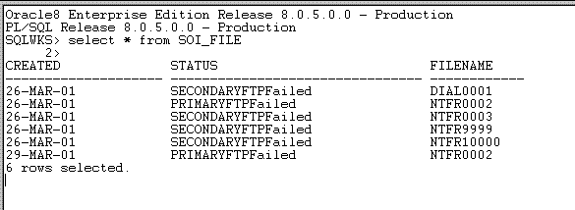
Communications Failures
If a failure in communications is experienced, a failure message is written to the SOI_FILE Table, in the Status field.

